Slide 1



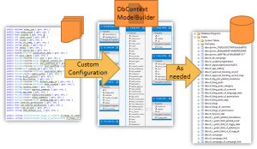

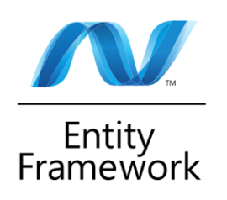
Entity Framework: Code First
Database
Applications
SoftUni Team
Technical Trainers
Software University
http://softuni.bg

Slide 2


Table of Contents
EF Modelling Workflows
Code First Main Parts
Domain Classes (Models)
DbContext and DbSet
Database connection
Using Code First Migrations
Configuring Mappings

Slide 3
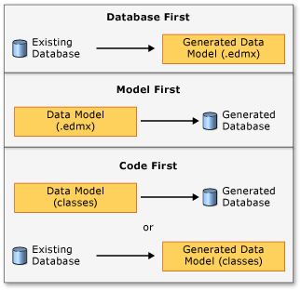
EF Modeling Workflows
EF supports three modeling workflows:
Database First
Create models from existing DB schema (DB → C# classes)
Model First
Create models in the EF designer in VS
Code First
Write models and combine them in DbContext (C# classes → DB)

Slide 4
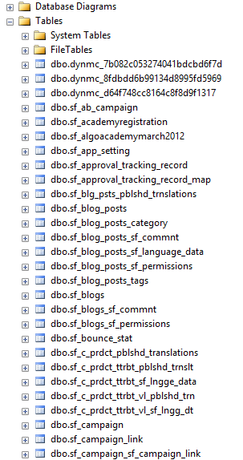
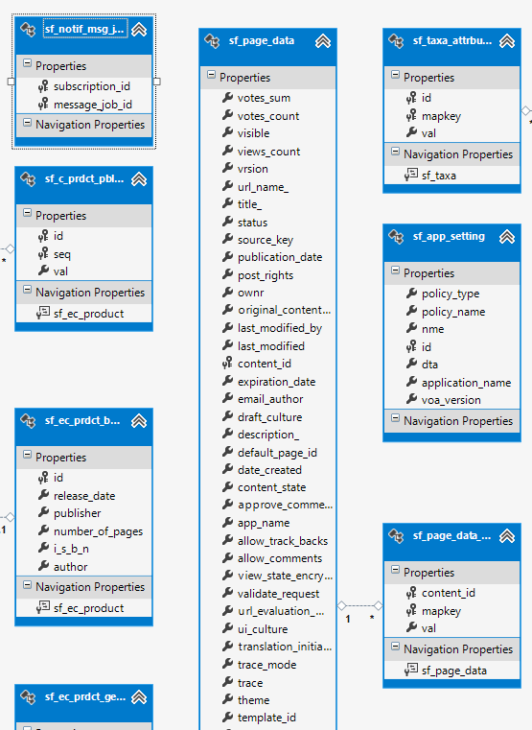
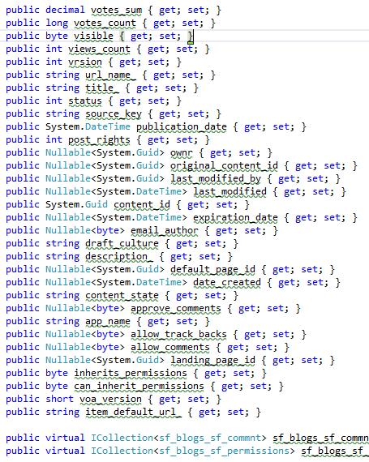
Database First Modeling Workflow
Create models as database tables and then generate code (models) from them
DB
EDMX Model
Domain classes

Slide 5
Model First Modeling Workflow
Domain classes
EDMX Model
DB

Slide 6
Code First Modeling Workflow
Domain classes
DbContext & ModelBuilder
DB
Custom Configuration
As needed

Slide 7
Why Use Code First?
Write code without having to define mappings in XML or create database models
Define objects in POCO
Reuse these models and their attributes
No base classes required
Enables database persistence with no configuration
Can use automatic migrations
Can use data annotations (Key, Required, etc.)

Slide 8

Code First Main Parts
Domain Classes, DbContext and DbSet

Slide 9
Domain Classes (Models)
Bunch of normal C# classes (POCO)
May contain navigation properties
Recommended to be in a separate class library
public class PostAnswer
{
public int PostAnswerId { get; set; }
public string Content { get; set; }
public int PostId { get; set; }
public virtual Post Post { get; set; }
}
Primary key
Foreign key
Virtual for lazy loading
Navigation property

Slide 10
Domain Classes (Models) (2)
Another example of domain class (model)
public class Post
{
private ICollection<PostAnswer> answers;
public Post()
{
this.answers = new HashSet<PostAnswer>();
}
public virtual ICollection<PostAnswer> Answers
{
get { return this.answers; }
set { this.answers = value; }
}
public PostType Type { get; set; }
}
Prevents
NullReferenceException
Navigation property
Enumeration

Slide 11
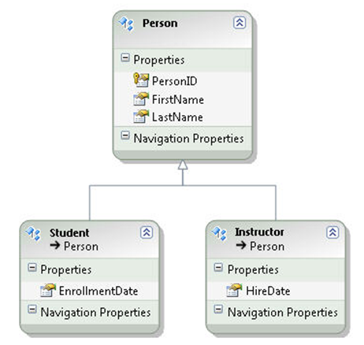

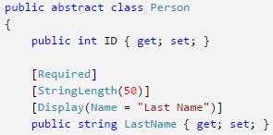
Creating Domain Classes (Models)
Live Demo

Slide 12
The DbContext Class
A class that inherits from DbContext
Manages model classes using DbSet<T> type
Implements identity tracking, change tracking
Provides API for CRUD operations and LINQ-based data access
Recommended to be in a separate class library
Don't forget to reference the Entity Framework library
Use the NuGet package manager
Use several DbContext if you have too much models

Slide 13
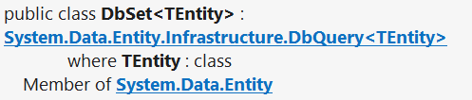
DbSet Type
Collection of single entity type
Set operations: Add, Attach, Remove, Find
Use with DbContext to query database
public DbSet<Post> Posts { get; set; }

Slide 14
Defining DbContext Class – Example
using System.Data.Entity;
using CodeFirst.Models;
public class ForumContext : DbContext
{
public DbSet<Category> Categories { get; set; }
public DbSet<Post> Posts { get; set; }
public DbSet<PostAnswer> PostAnswers { get; set; }
public DbSet<Tag> Tags { get; set; }
}

Slide 15

Creating DbContext
Live Demo

Slide 16
CRUD Operations with EF Code First
var db = new ForumContext();
var category = new Category { Name = "Database course" };
db.Categories.Add(category);
var post = new Post();
post.Title = "Homework Deadline";
post.Content = "Please extend the homework deadline";
post.Type = PostType.Normal;
post.Category = category;
post.Tags.Add(new Tag { Text = "homework" });
post.Tags.Add(new Tag { Text = "deadline" });
db.Posts.Add(post);
db.SaveChanges();

Slide 17
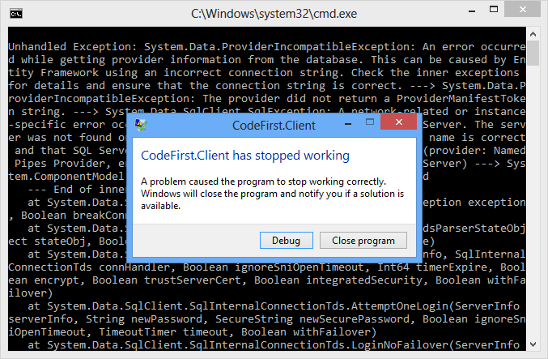
CRUD Operations with EF Code First
Live Demo

Slide 18
Where is My Data?
Default App.config file contains link to default connection factory
Server name by default:
(localdb)\v11.0 or (localdb)\MSSQLLocalDB
We can use VS server explorer to view database
<entityFramework>
<defaultConnectionFactory type="System.Data.Entity. Infrastructure.LocalDbConnectionFactory, EntityFramework">
<parameters>
<parameter value="v11.0" />
</parameters>
</defaultConnectionFactory>
</entityFramework>

Slide 19
How to Connect to SQL Server?
First, create a context constructor that calls the base constructor with connection name
Then add the connection string in app.config
public class ForumContext : DbContext
{
public ForumContext() : base("ForumDb") { … }
…
}
<connectionStrings>
<add name="ForumDb" connectionString="Data Source=.;
initial catalog=ForumDb;Integrated Security=True"
providerName="System.Data.SqlClient" />
</connectionStrings>

Slide 20
Database Connection Workflow
Connection String Available?
Yes
No
Database Exists?
Yes
Build String (SQL Server Express or Create Local DB)
Use Database
No
Create Database

Slide 21
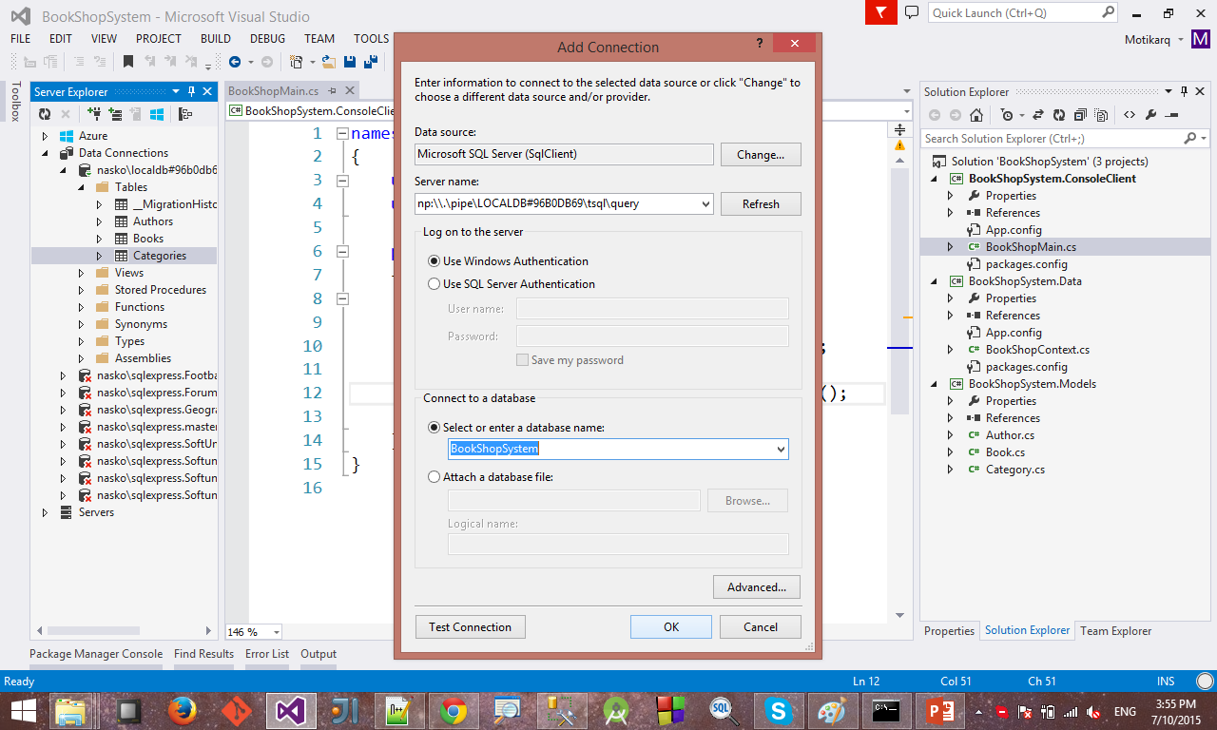
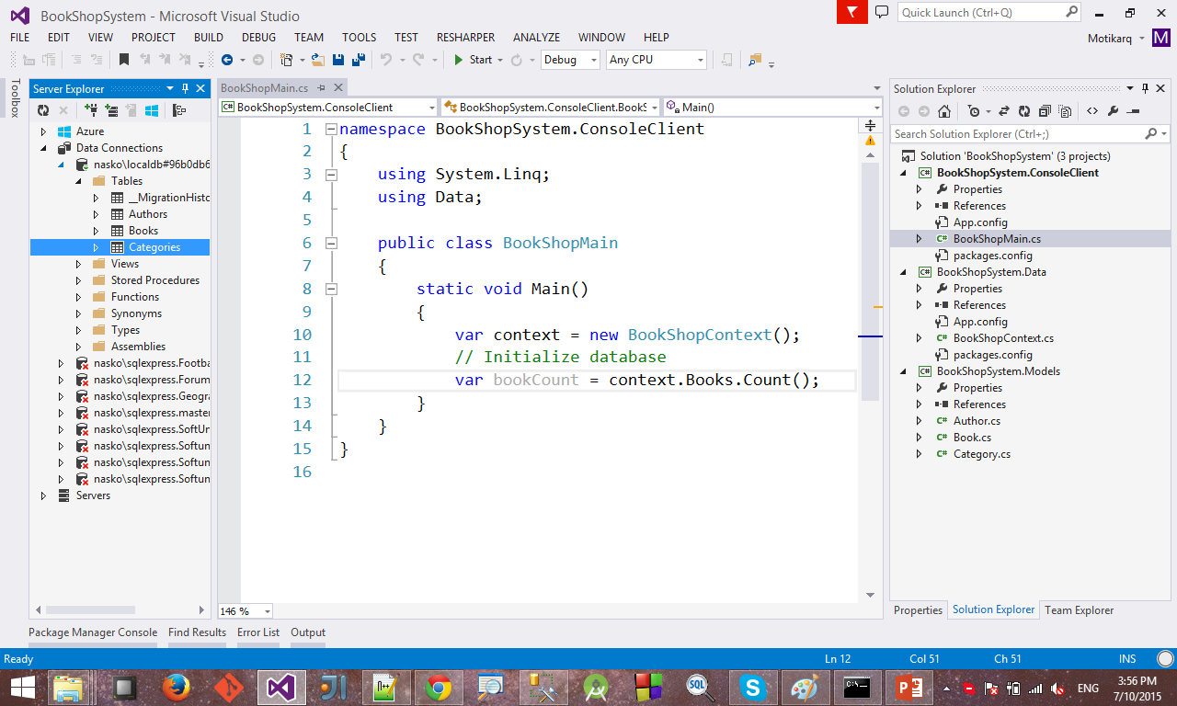
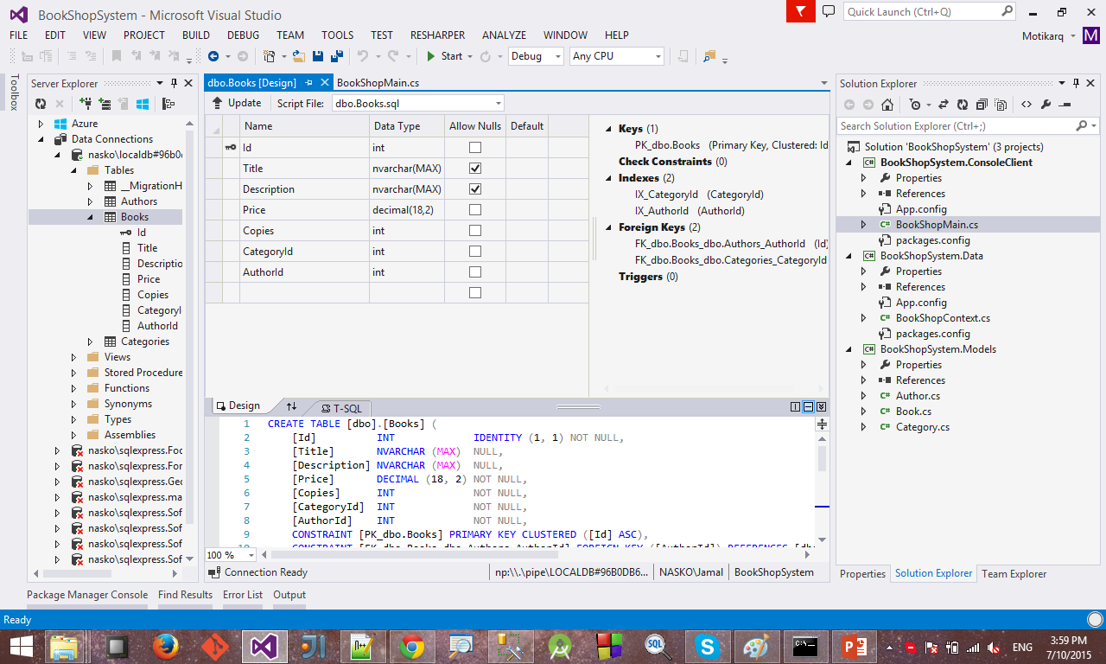
Connecting to LocalDB in Visual Studio
Connecting to LocalDB:
http://stackoverflow.com/a/21565688

Slide 22
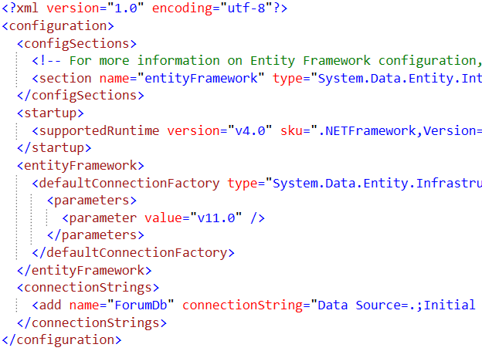
Change Database Connection
Live Demo

Slide 23

Using Code EF First Migrations

Slide 24
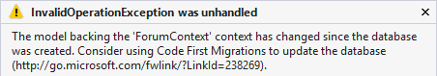
Changes in Domain Classes
What happens when we change our models?
Entity Framework compares our model with the model from the __MigrationHistory table in the DB
By default Entity Framework only creates the database
EF doesn't do any schema changes after that
Using Code First Migrations we can handle differences between models and database

Slide 25
Code First Migrations
Enable Code First Migrations
Open Package Manager Console
Run Enable-Migrations command
This will create some initial jumpstart code
-EnableAutomaticMigrations for auto migrations
Two types of migrations
Automatic migrations
Set AutomaticMigrationsEnabled = true;
Code-based (providing full control)
Separate C# code file for every migration

Slide 26
Database Migration Strategies
CreateDatabaseIfNotExists
Default migration
DropCreateDatabaseIfModelChanges
We lose all the data when the model changes
DropCreateDatabaseAlways
Great for automated integration testing
MigrateDatabaseToLatestVersion
This option uses our migrations
Custom migrations
Implement IDatabaseInitializer for custom migration strategy

Slide 27
Use Code First Migrations
First, enable code first migrations
Second, we need to tell to Entity Framework to use our migrations with code (or in App.config)
We can configure automatic migration
Database.SetInitializer( new MigrateDatabaseToLatestVersion<ForumContext, Configuration>());
This will allow us to delete or change properties
public Configuration()
{
this.AutomaticMigrationsEnabled = true;
this.AutomaticMigrationDataLossAllowed = true;
}

Slide 28
Seeding the Database
During a migration we can seed the database with some data using the Seed() method
This method will be run after each migration
protected override void Seed(ForumContext context)
{
/* This method will be called after migrating to the latest version.
You can use the DbSet<T>.AddOrUpdate() helper extension method
to avoid creating duplicate seed data. E.g. */
context.Tags.AddOrUpdate(t => t.Text, new Tag { Text = "C#" });
context.SaveChanges();
}

Slide 29

Code First Migrations
Live Demo

Slide 30

Configure Mappings
Using Data Annotations and EF Fluent API

Slide 31

Configure Mappings
Entity Framework respects mapping details from two sources:
Data annotation attributes in the models
E.g. [Key], [Required], [MaxLength]
Can be reused for validation purposes
Fluent API code mapping configuration
By overriding OnModelCreating method
By using custom configuration classes
Use one approach or the other

Slide 32
Data Annotations
There is a bunch of data annotation attributes
System.ComponentModel.DataAnnotations
Specify the primary key of the table: [Key]
For validation:
[StringLength], [MaxLength], [MinLength], [Required]
Schema:
[Column], [Table], [ComplexType], [ConcurrencyCheck], [Timestamp], [InverseProperty], [ForeignKey], [DatabaseGenerated], [NotMapped], [Index]
EF 6 supports custom attributes by using custom conventions

Slide 33
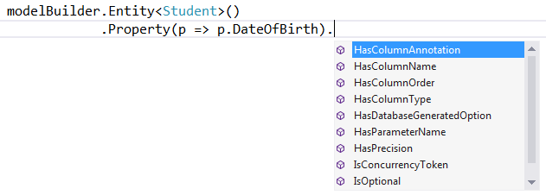

Entity Framework Fluent API
Using the ModelBuilder

Slide 34
EF Fluent API for Mappings
By overriding DbContext.OnModelCreating we can specify mapping configurations:
protected override void OnModelCreating(DbModelBuilder modelBuilder)
{
modelBuilder.Entity<Tag>()
.HasKey(x => x.TagId);
modelBuilder.Entity<Tag>()
.Property(x => Text).IsUnicode(true);
modelBuilder.Entity<Tag>()
.Property(x => x.Text).HasMaxLength(255);
modelBuilder.Entity<Tag>()
.Property(x => x.Text).IsFixedLength();
base.OnModelCreating(modelBuilder);
}

Slide 35
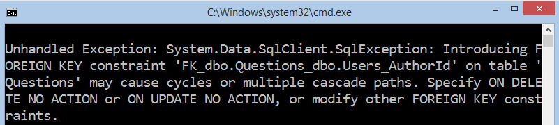
Solving Cascade Delete Issue with Fluent API
When there several cascade delete paths, EF throws an exception
Two solutions with Fluent API:
Remove default cascade delete convention globally
Manually configure the relation
modelBuilder.Conventions
.Remove<OneToManyCascadeDeleteConvention>();
modelBuilder.Entity<User>()
.HasMany(u => u.Answers)
.WithRequired(a => a.User)
.WillCascadeOnDelete(false);

Slide 36
Solving Cascade Delete Issue with Fluent API
When there several cascade delete paths, EF throws an exception
Two solutions with Fluent API:
Remove default cascade delete convention globally
Manually configure the relation
modelBuilder.Conventions
.Remove<OneToManyCascadeDeleteConvention>();
modelBuilder.Entity<User>()
.HasMany(u => u.Answers)
.WithRequired(a => a.User)
.WillCascadeOnDelete(false);

Slide 37
Manually Setting Many-to-Many Relation
In some cases EF does not properly recognize the relation
E.g. we want a User to have many friends (other users)
We have to manually map the relation to a many-to-many table
modelBuilder.Entity<User>()
.HasMany(u => u.Friends)
.WithMany()
.Map(m =>
{
m.MapLeftKey("UserId");
m.MapRightKey("FriendId");
m.ToTable("UserFriends");
});

Slide 38
EF Fluent API Configurations
.Entity()
Map: Table Name, Schema
Inheritance Hierarchies, Complex Types
Entity -> Multiple Tables
Table -> Multiple Entities
Specify Key (including Composite Keys)
.Property()
Attributes (and Validation)
Map: Column Name, Type, Order
Relationships
Concurrency

Slide 39

EF: Configure Mappings
Live Demo

Slide 40









Entity Framework Code First
https://softuni.bg/courses/database-applications/

Slide 41
License
This course (slides, examples, demos, videos, homework, etc.) is licensed under the "Creative Commons Attribution-NonCommercial-ShareAlike 4.0 International" license
Attribution: this work may contain portions from
"Databases" course by Telerik Academy under CC-BY-NC-SA license

Slide 42





Free Trainings @ Software University
Software University Foundation – softuni.org
Software University – High-Quality Education, Profession and Job for Software Developers
softuni.bg
Software University @ Facebook
facebook.com/SoftwareUniversity
Software University @ YouTube
youtube.com/SoftwareUniversity
Software University Forums – forum.softuni.bg

